Slide 1
Visualization of CNN
Submitted by:
JOY Das
Tasfia azim

Slide 2
Layers of CNN
1. Convolution Layer
2. Pooling Layer
3. Fully Connected Layer or Dense Layer

Slide 3
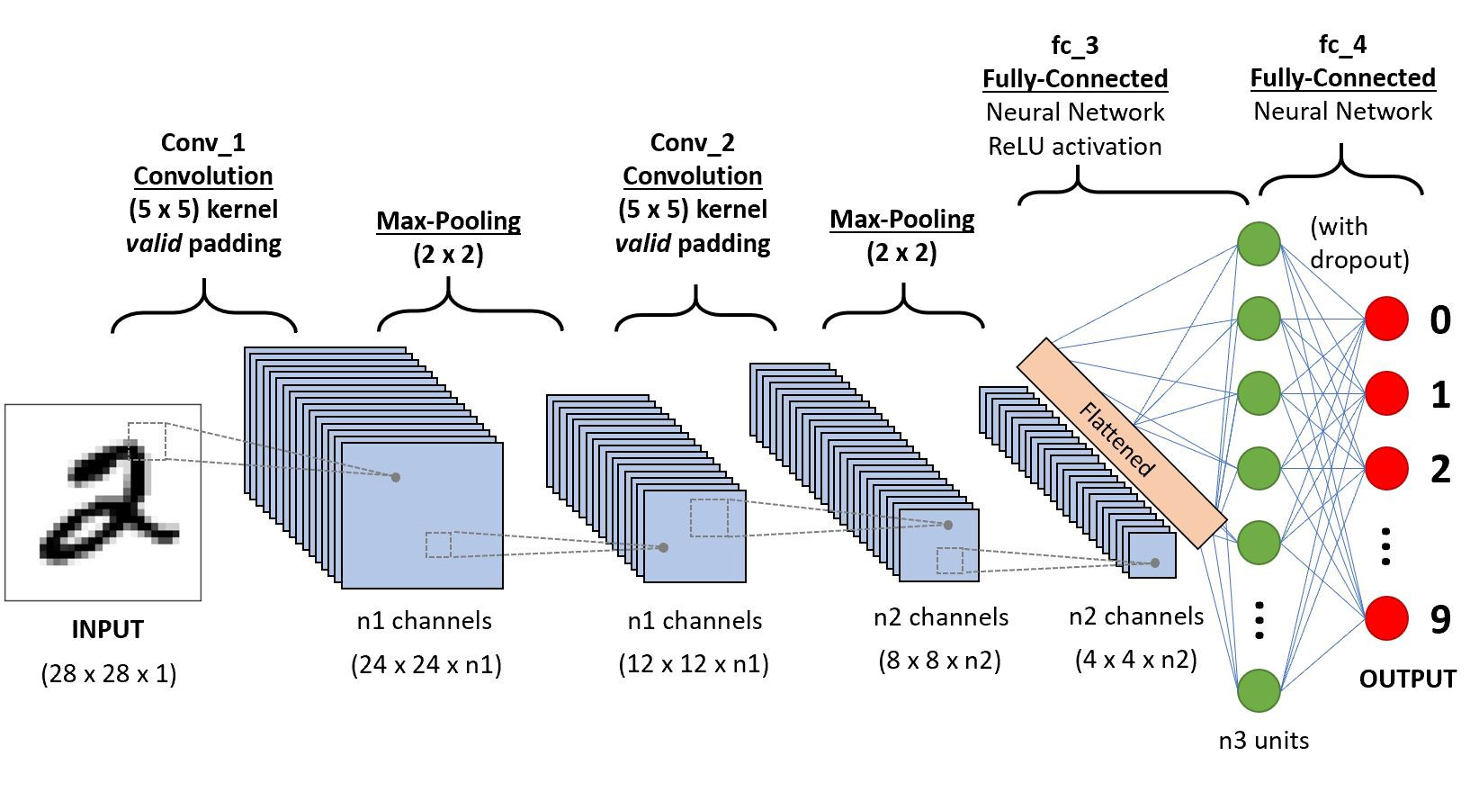
A simple CNN Diagram

Slide 4
Visual Presentation of Convolution Layer
In Convolution layer firstly we take an image and reshape it as our calculation and then we apply filters to our input image.
There can be more than one convolution layers in our network, this design is up to us.
If we take a 6*6 matrix for input and apply a filter what is 3*3 then we will get a 4*4 matrix as output after applying our filter.
N[1] = ( n[0] – f[1] / s[1] ) – 1 Where,
n[0] = height/width of input image
f[1] = filter height/width
s[1] = number of stride
n[1] = output of first image after applying filter

Slide 5
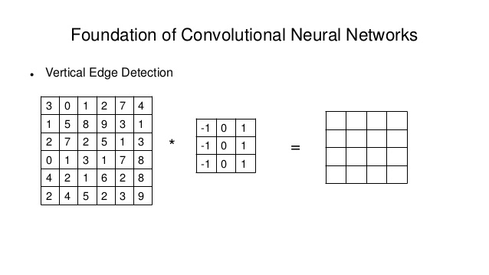
Visual Presentation of Convolution Layer

Slide 6
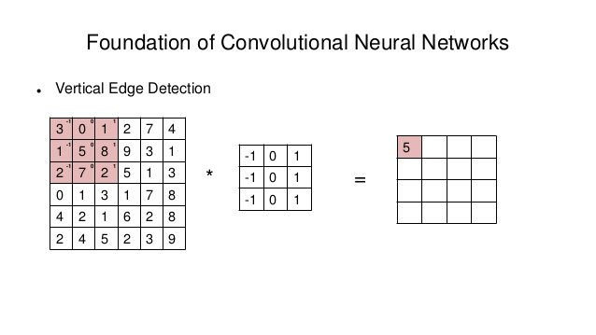
Visual Presentation of Convolution Layer
The calculation behind it is:
(3*-1)+(0*0)+(1*1)+(1*-1)+(5*0)+(8*1)+(2*-1)+(7*0)+(2*1) = 5

Slide 7
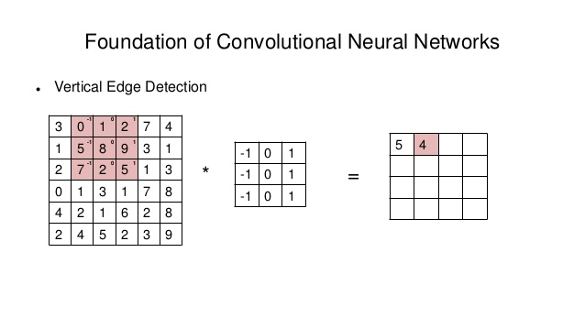
Visual Presentation of Convolution Layer
Here, Stride is one so it will move 1 column to the right and end of the row it will move one down.
Here the calculation is:
(0*-1)+(1*0)+(2*1)+(5*-1)+(8*0)+(9*1)+(7*-1)+(2*0)+(5*1) = 4
And so on.

Slide 8
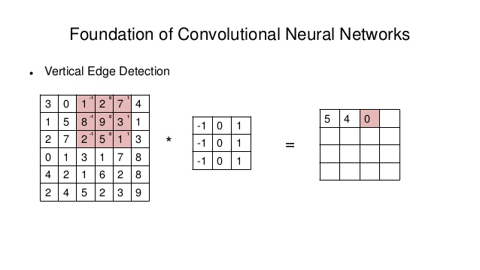
Visual Presentation of Convolution Layer

Slide 9
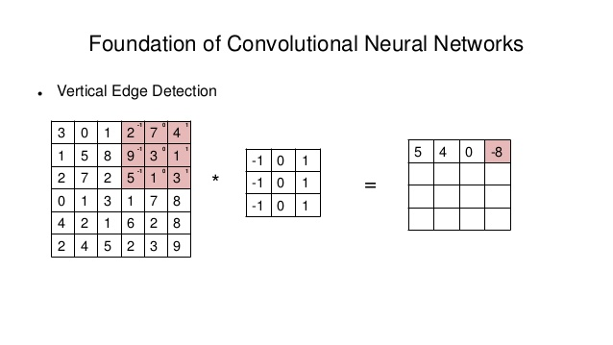
Visual Presentation of Convolution Layer

Slide 10
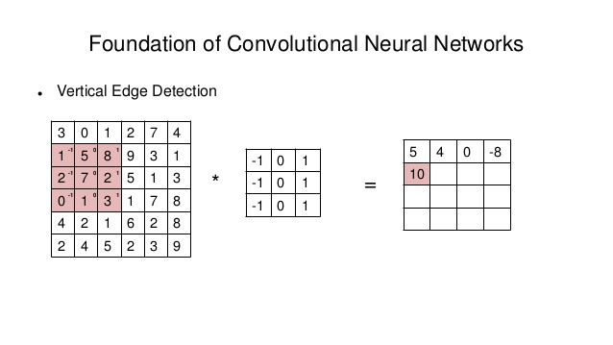
Visual Presentation of Convolution Layer

Slide 11
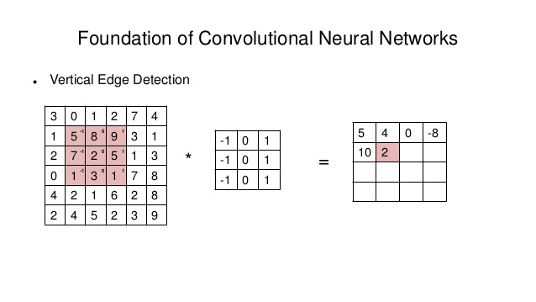
Visual Presentation of Convolution Layer

Slide 12
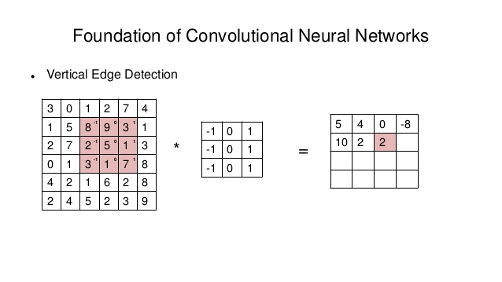
Visual Presentation of Convolution Layer

Slide 13
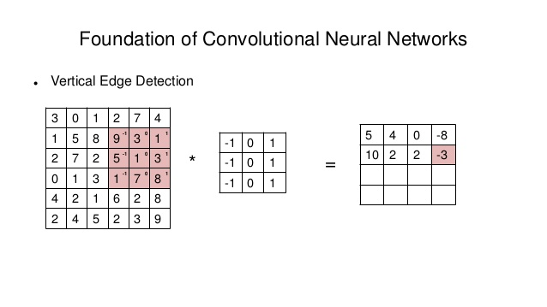
Visual Presentation of Convolution Layer

Slide 14
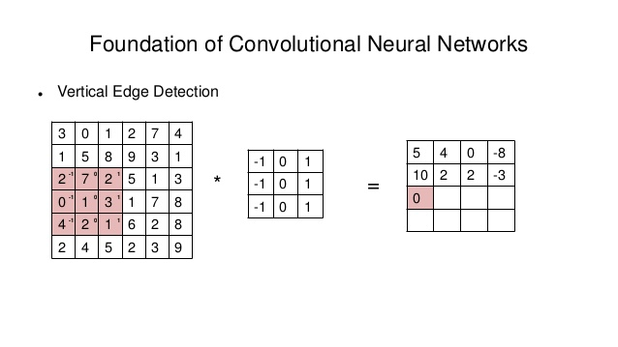
Visual Presentation of Convolution Layer

Slide 15
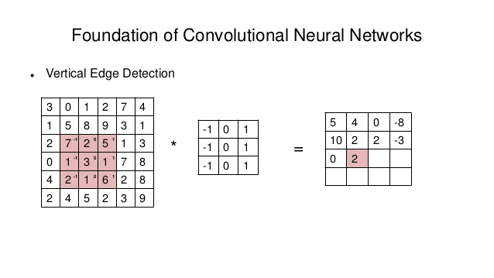
Visual Presentation of Convolution Layer

Slide 16
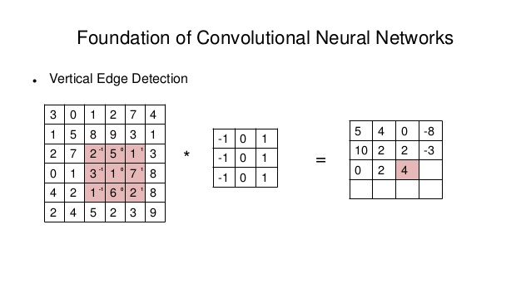
Visual Presentation of Convolution Layer

Slide 17
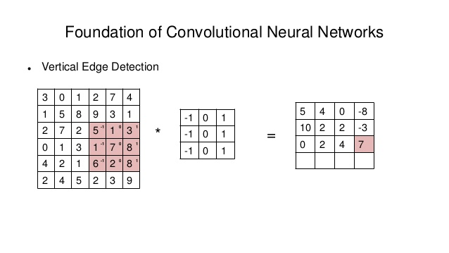
Visual Presentation of Convolution Layer

Slide 18
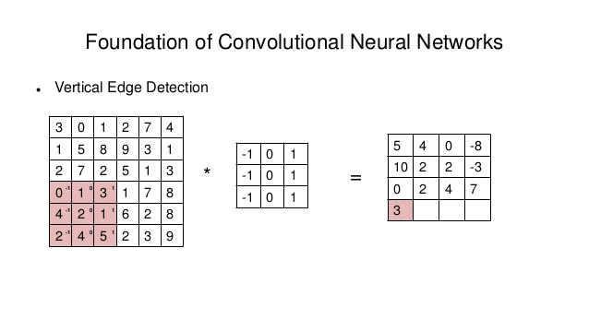
Visual Presentation of Convolution Layer

Slide 19
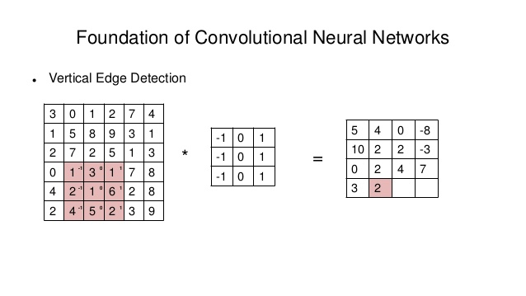
Visual Presentation of Convolution Layer

Slide 20
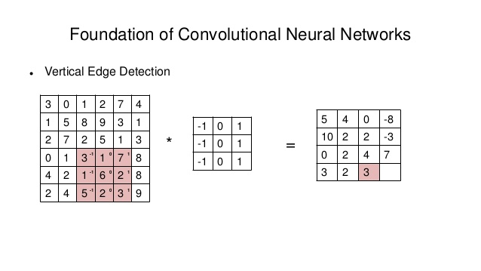
Visual Presentation of Convolution Layer

Slide 21
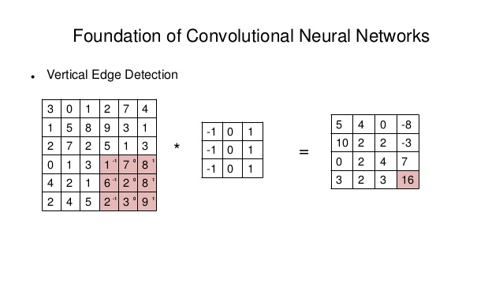
Visual Presentation of Convolution Layer

Slide 22
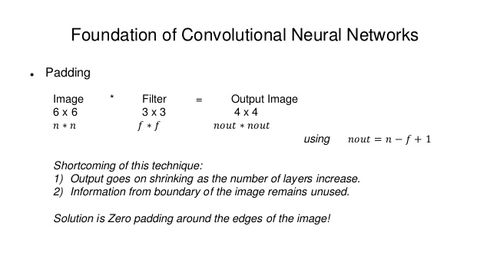
Visual Presentation of Convolution Layer

Slide 23
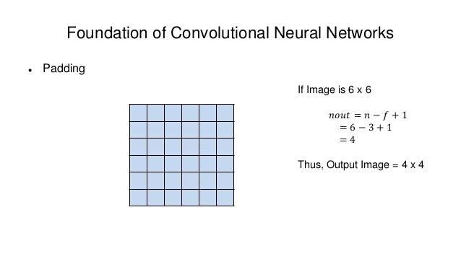
Visual Presentation of Convolution Layer

Slide 24
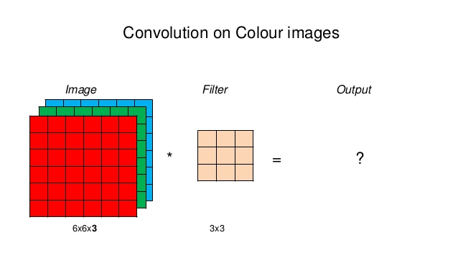

Slide 25
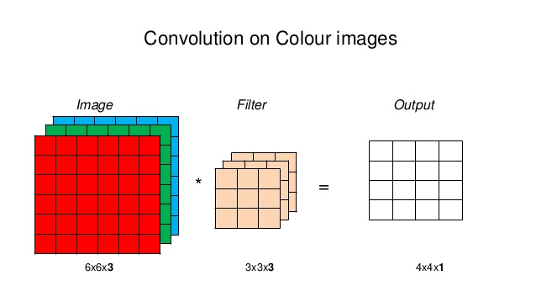

Slide 26
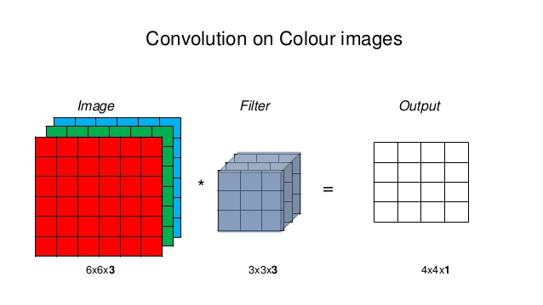

Slide 27
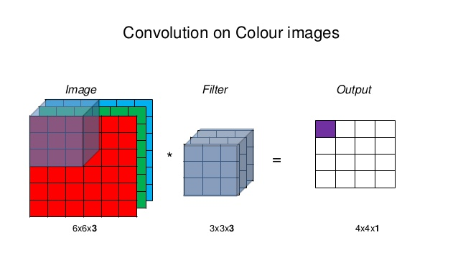

Slide 28
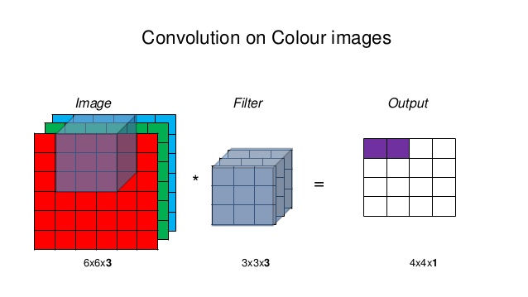

Slide 29
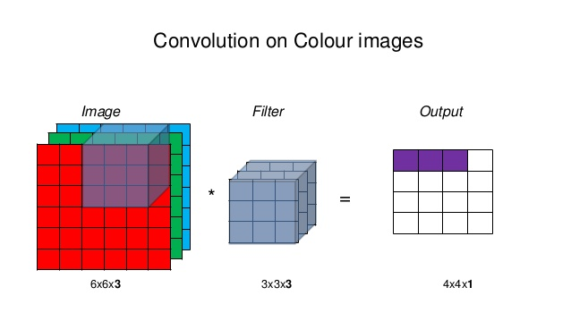

Slide 30
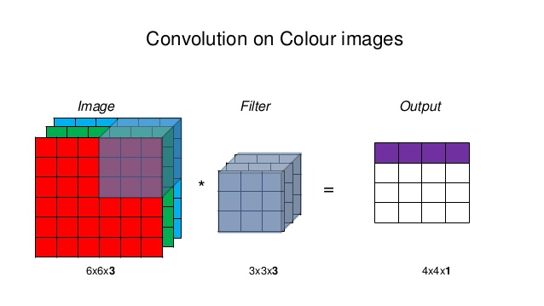

Slide 31
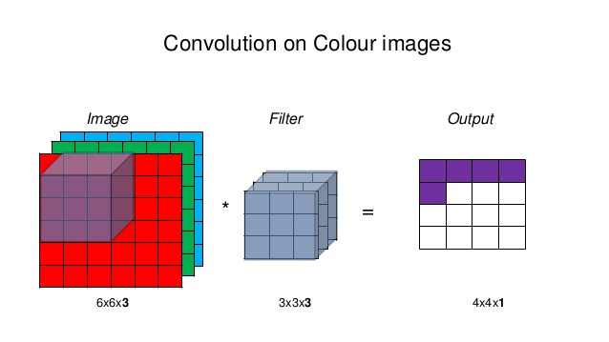

Slide 32
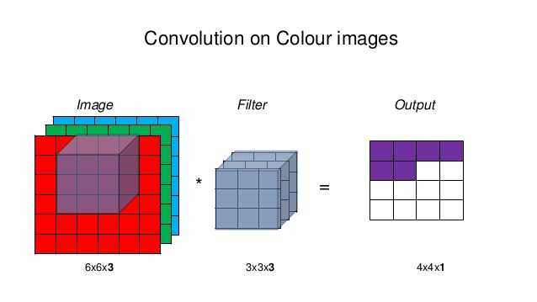

Slide 33
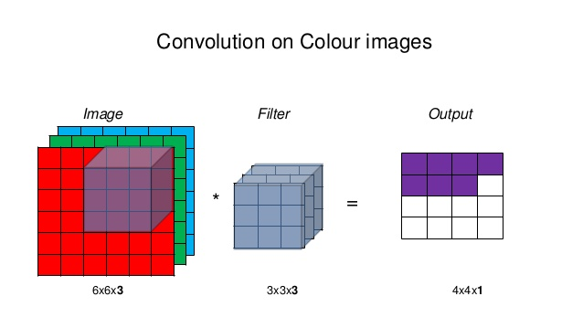

Slide 34
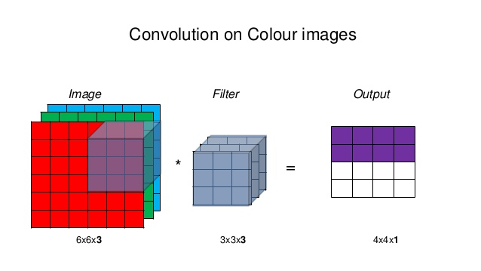

Slide 35
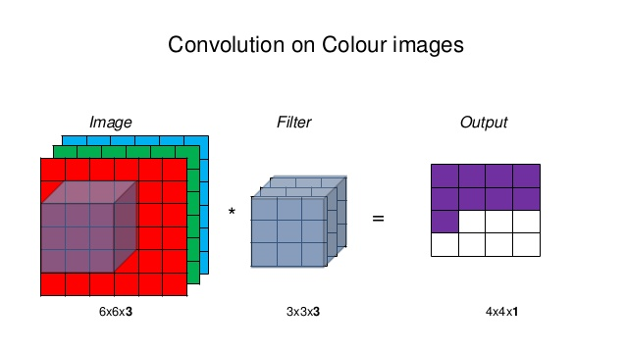

Slide 36
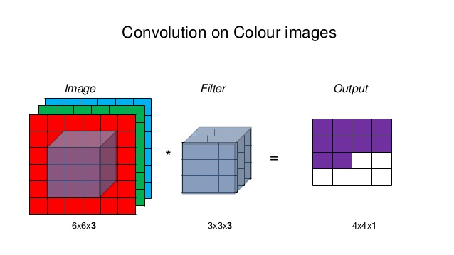

Slide 37
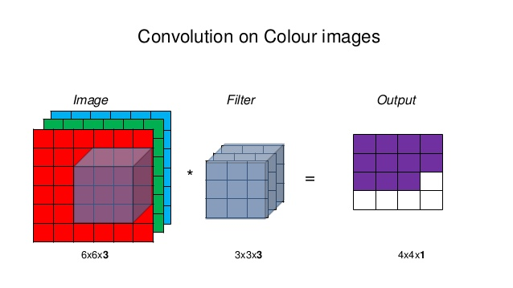

Slide 38
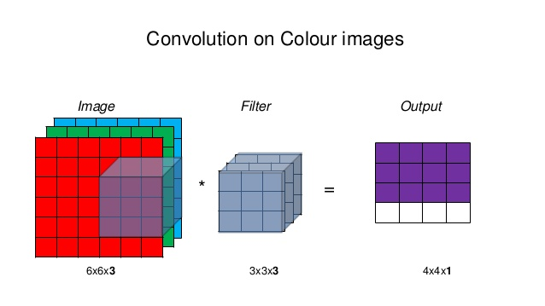

Slide 39
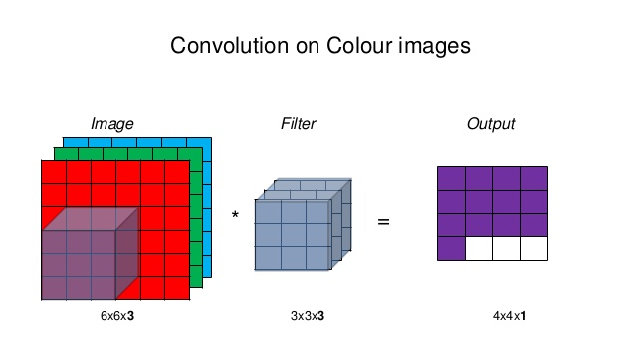

Slide 40
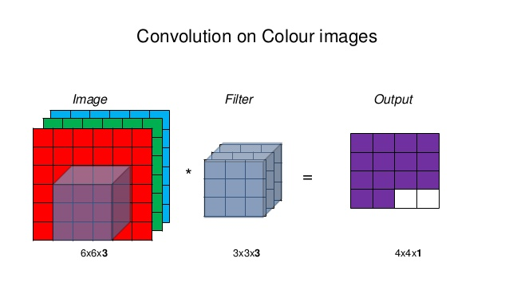

Slide 41
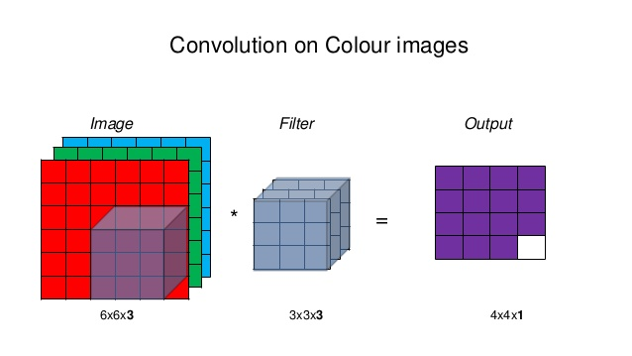

Slide 42
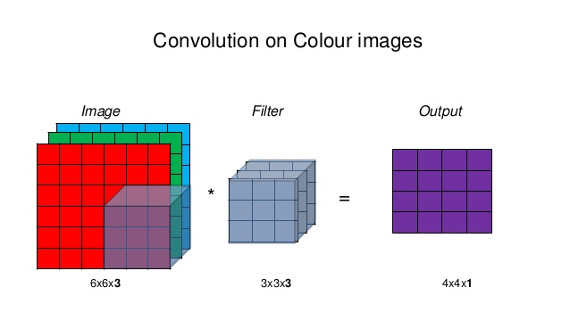

Slide 43
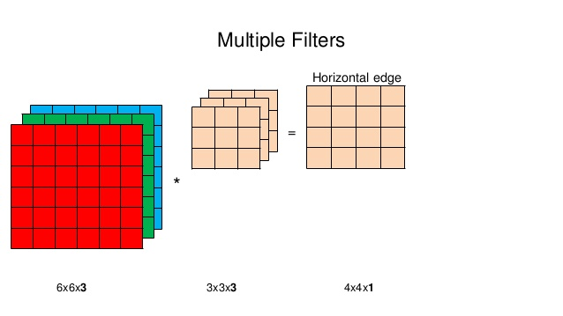

Slide 44
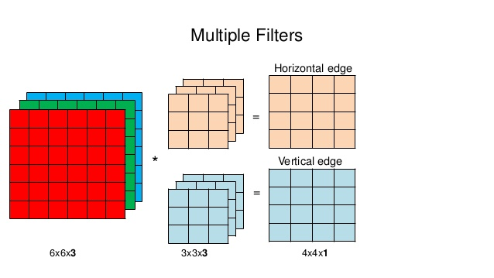

Slide 45
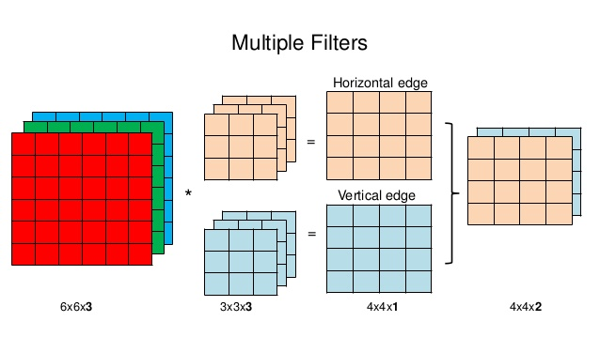

Slide 46
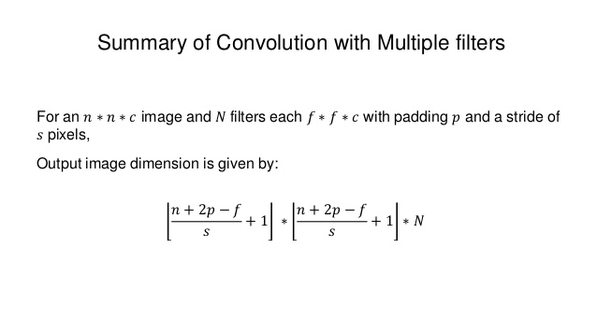

Slide 47
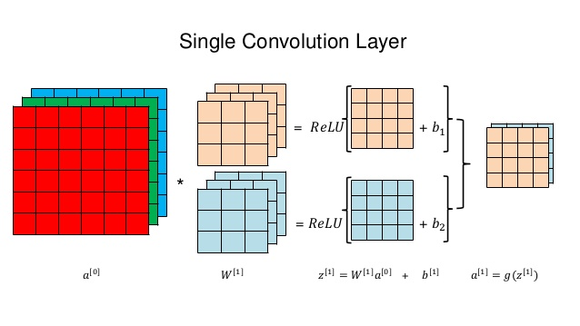

Slide 48
Pooling Layer Purpose: 1) To reduce the size of the layer to speed up computation. 2) To retain robust features.
Types :
1) Max Pool
2) Average Pool

Slide 49
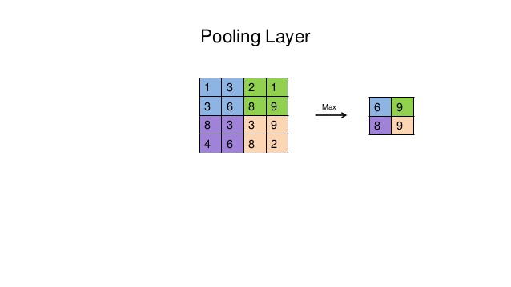

Slide 50
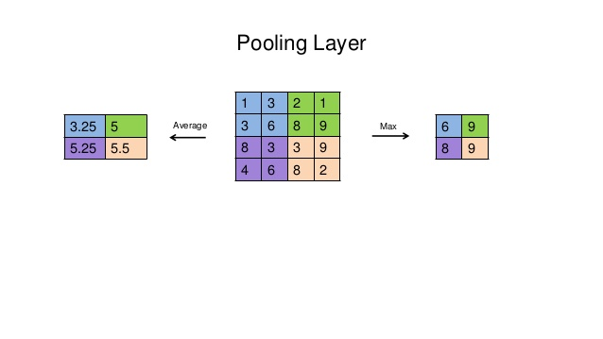

Slide 51
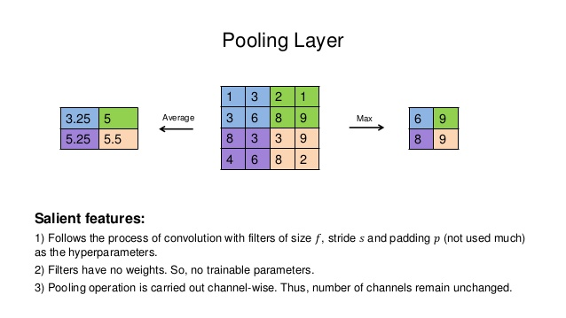

Slide 52
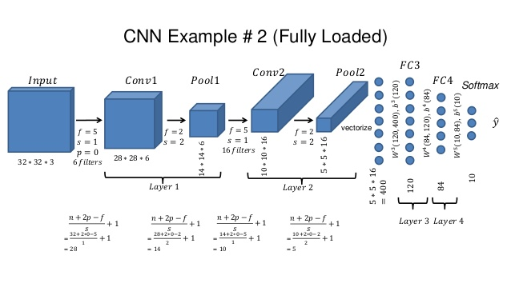

Slide 53
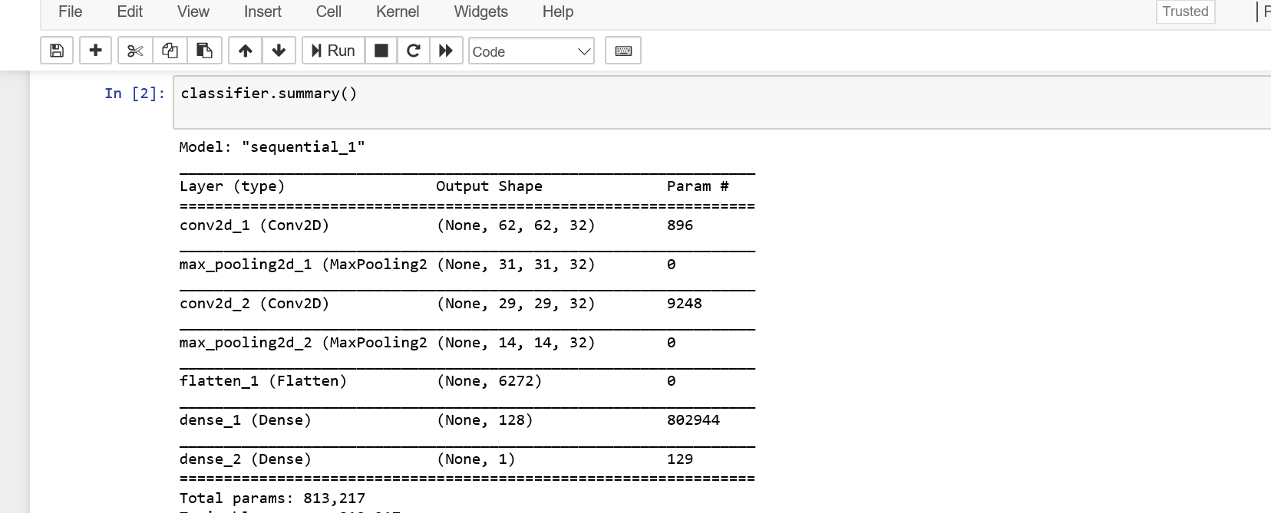
Our Primary Network

Slide 54
Parameter Calculation
Calculation of parameter is:
Filter(Height*width*depth+1) * number of filter
Where 1 is bias.
If the first convolution layer the filter is (3*3) and filter number is 32 then the total parameter will be (for RGB calculation):
((3*3*3)+1)*32) = 896 For the first layer

Slide 55
Parameter Calculation
This calculation can be written as :
((height*width*depth) * number of filters ) + total number of bias
So again ((3*3*3)*32)+32 = 896
This is the calculation of parameter in CNN

Slide 56
Activation size calculation
Calculation of activation size in Convolution Layer
Activation size comes from Activation shape, For Example, If in the very first layer we consider an image which will act as input in our network which size is 64 * 64 * 3 (This 3 is for RGB image)
So, Input shape is: (64, 64, 3) And the calculation will be
Input Image Height * Input Image width * Input Image Depth
So here (64*64*3) is equal 12288. This is the activation size.

Slide 57
Activation size calculation
Let us give an another Example
If the Activation shape is 28,28,8
Here 8 is after applying 8 filter in previous layer the depth is 8
The activation size will be 28*28*8 = 6272

Slide 58
The End

